Slide 1



Blockchain Champion
Sriram
Technology of Trust

Slide 2
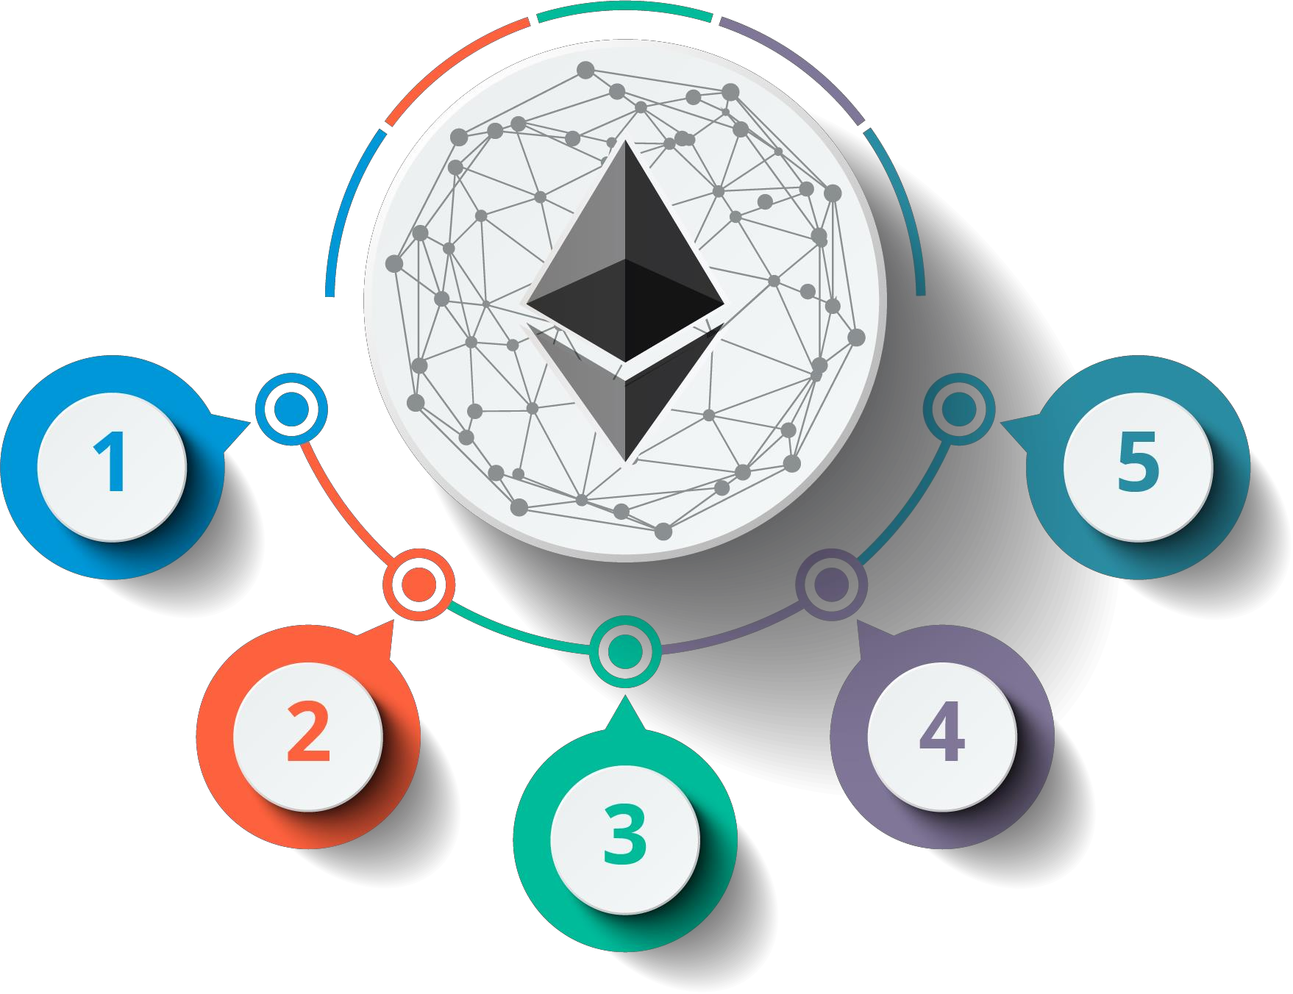









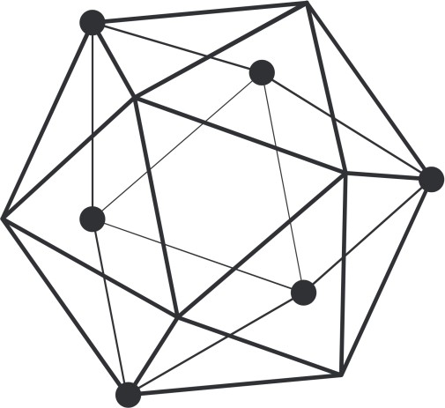



Course Outline
Delving in to Blockchain
Blockchain Prospects
Mastering Ethereum with Solidity
Hyperledger Expert
Bitcoin Mining

Slide 3


1. Delving in to Blockchain

Slide 4

Course Objectives
After completing this module, you should be able to:
Understand different types of networks
Cryptocurrency and its growth
Explain Blockchain and its uses
Grasp the components of a Blockchain ecosystem
Induce the structure and mechanisms of a Blockchain
Deduce various cryptography and consensus algorithm
Fathom different types of Blockchain
Infer various types of Blockchain platforms
Key Concepts in Blockchain
Bitcoin and its usage

Slide 5
2. Mastering Ethereum

Slide 6
Course Objectives
After completing this module, you should be able to:
Apprehend another Blockchain platform: Ethereum
Perceive the Ethereum Ecosystem
Understand how mining works in Ethereum
Learn Solidity programming language

Slide 7
3. Cryptocurrency & Bitcoin Mining

Slide 8
Course Objectives
After completing this module, you should be able to:
Understanding different Cryptocurrencies
Understanding ICO
ICO Regulations, Tokens & Platform
ICO Strategic and Marketing Techniques
Deduce the purpose of mining
Comprehend bitcoin mining
Perceive the importance of mining pools
Infer bitcoin security

Slide 9
4. Hyperledger Expert

Slide 10
Course Objectives
After completing this module, you should be able to:
Comprehend the Hyperledger project
Infer the Hyperledger architecture
Explore the consensus mechanism in Hyperledger
Landscape - Four major Hyperledger frameworks
Develop & deploy business networks
Interact with Hyperledger Fabric Blockchain using
Hyperledger Composer
Infer Hyperledger Fabric

Slide 11
5. Blockchain Prospects

Slide 12
Course Objectives
After completing this module, you should be able to:
Blockchain Use cases

Slide 13


Copyright © 2017, edureka and/or its affiliates. All rights reserved.

Slide 14

Copyright © 2017, edureka and/or its affiliates. All rights reserved.

Slide 15


